Slide 1

American Foundry Society
Saginaw Valley Chapter
Foundry in a Box
American Foundry Society
Saginaw Valley Chapter

Slide 2

American Foundry Society
Saginaw Valley Chapter
Foundry in a Box

Slide 3

Marshalling Area for
Foundry In A Box aa
Demonstration
American Foundry Society
Saginaw Valley Chapter
www.saginawvalleyafs.org

Slide 4

Name Station
Print your name on an index card to track your casting
Steve Jones
American Foundry Society
Saginaw Valley Chapter
www.saginawvalleyafs.org

Slide 5
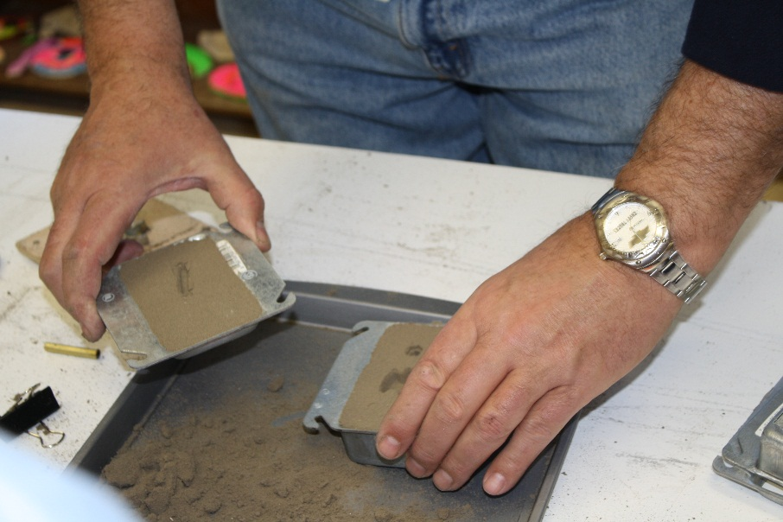
Casting Sand Molding
American Foundry Society
Saginaw Valley Chapter
www.saginawvalleyafs.org

Slide 6
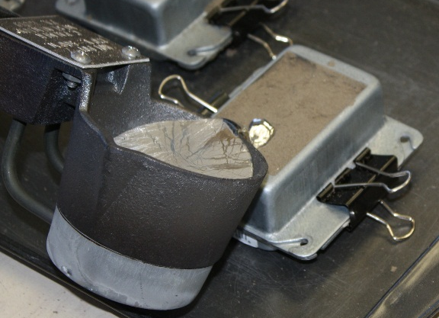
Casting Metal Pouring and Extraction
American Foundry Society
Saginaw Valley Chapter
www.saginawvalleyafs.org

Slide 7
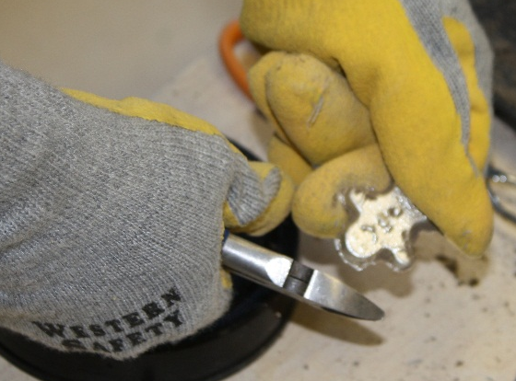
Casting Finishing
American Foundry Society
Saginaw Valley Chapter
www.saginawvalleyafs.org

Slide 8
Pouring Molten Metal
American Foundry Society
Saginaw Valley Chapter
www.saginawvalleyafs.org

