Slide 1
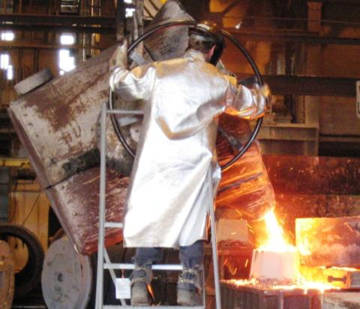

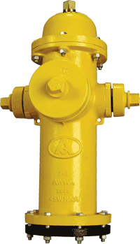
Foundry-In-Da-Box
Our Messages:
Metal castings are important to everyone.
Making castings is fun.
The more you learn in school, the more you can enjoy your career.
Notes:
Ask yourself this question, “How many of you know someone that comes home from work and complains about their job?”
Almost every student will raise their hand. (Many of the teachers will raise their hands also.)
Then ask, “Would you like to have a job that you enjoy or one that you complain about?”
Then state, “The more you learn in school, the more opportunities you will have for an enjoyable career.”
On Friday 12-11-15, the Saginaw Valley Chapter of the American Foundry Society will be here in Frankenmuth to expose you to the casting industry. Just maybe this will be your field of choice someday!

Slide 2

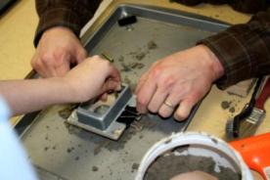
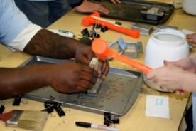
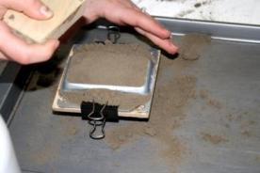
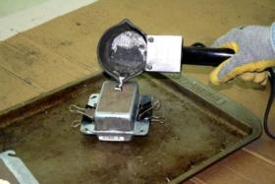
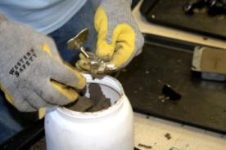
Saginaw Valley Chapter of American Foundry Society be in
  Frankenmuth on Friday December 11, 2015 for an
  Educational Experience.
  Everyone gets to Play in the Sand, Make a Mold, Pour Casting, Shake Mold Out , and Keep the Casting.
Notes:
Pictures of Making Mold which students get to do with help from foundry personnel.
Foundry personnel do the actual pouring of the mold with Tin. Tin is at 450 F, so typically do not allow students to pour mold unless more time for training is given. Students get to watch their mold being poured.
Foundry personnel then shakeout the mold, cutting the downsprue and runner off the casting, cool the casting, and then file any sharp edges. Student then gets to take the casting with him/her.

Slide 3
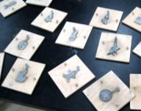
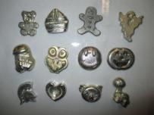
Patterns that are used to
make the castings
Castings after degated and filed
that students can take home
Notes:
Example of the patterns and then the castings students can choice from. Over 30 different patterns, not all shown in this picture.

Slide 4
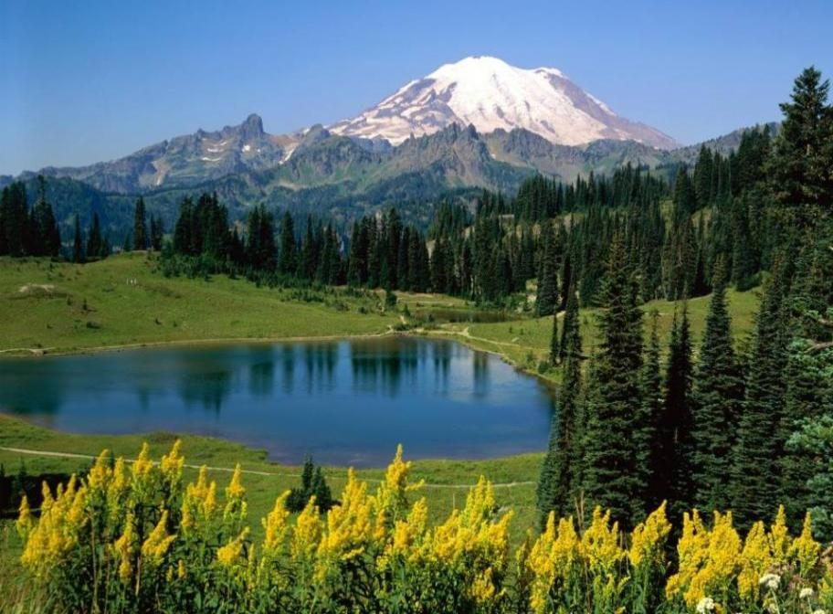
Can you find a useful natural object?
Notes:
It is very difficult to find a natural object that is useful in its natural shape.
Can you find something in this picture that is useful in its natural shape? (The answer you want is, “a tree”.)
If they suggest water, ask them, “what is the shape of water?” Explain that since it has no shape we can’t use it for this example.
If they suggest a rock. Explain that natural rocks are only useful if they just happen to be the exact size and shape that you need. Ask, “When was the last time you found a rock useful?” or, “Do your parents ever say, “Please go get a rock”?
When they suggest a tree, agree that it is a good answer and say, “OK, so we all go into the woods together and pull up a tree by the roots. Now we take it to your house and lay it in your front yard. How is it useful? We pulled it out of the ground so it will die and its leaves will fall off. It can’t give shade.” Explain that a tree is not useful unless it’s shape is changed. It must be cut into lumber to be useful. Even firewood must be cut into lengths that will fit into a fireplace.
“Manufacturing” is making things that are useful.

Slide 5
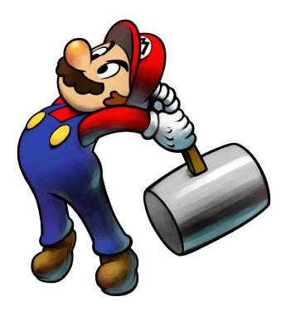

Manufacturing is changing natural
things into useful shapes.
How many ways can you change
the shape of something?
1. Cut
2. Smash
Notes:
Hold up a pair of bolt cutters, scissors and a hammer. Explain that there are only three basic ways to change the shape of an object;
Cut, smash or melt.
We could have a whole conversation about how manufacturing in the USA is not the clamor occupation of choice for up coming generations. Things like STEM events trying hard to correct this.

Slide 6
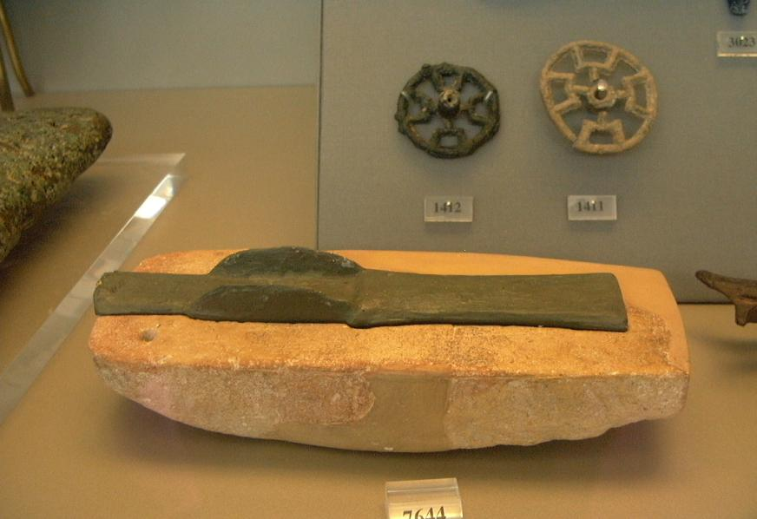
3. Cast to shape!
Prehistoric cast bronze axe head
Stone mold
National Archaeological Museum – Athens, Greece
Notes:
The primary way we form metal into a useful shape is by casting. You form a cavity that looks like a useful shape and then pour molten metal into it. Then you wait for it to freeze or solidify. When you remove it from the mold you have a useful object. This is a very old process. People have been doing this since the beginning of recorded history.
These photos were taken in 2004 at the National Archaeological Museum in Athens, Greece. The museum has a section dedicated to metallurgy. This prehistoric bronze axe head was cast in a stone mold. The bottom half of the mold is displayed with the casting in it. There are also two cast bronze wheels in the top of this photo. These castings are about 4000 years old.

Slide 7

Notes:
If video inserted correctly in to file it should run when link is accessed.

Slide 8
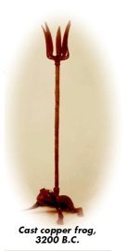
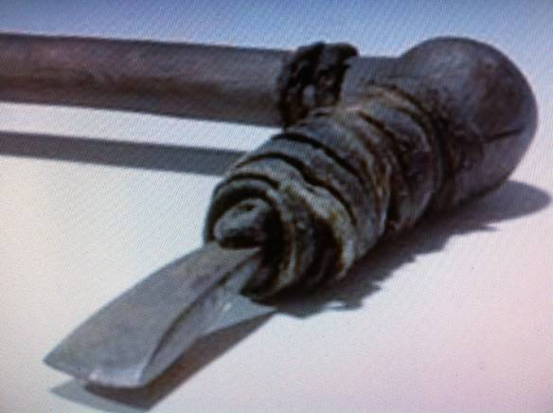
World’s oldest castings.
Copper axe found with the mummy of the “Ice Man” in 1991–3300 BC
Notes:
Here are the worlds oldest known castings.

Slide 9
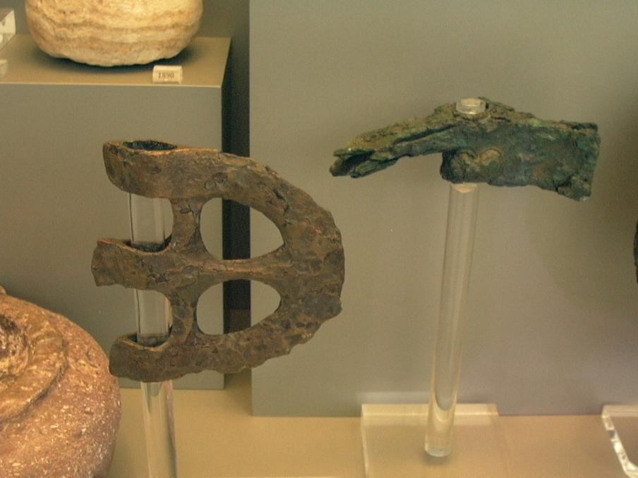
Prehistoric cast bronze axe heads
Notes:
Here are two more cast bronze axe heads.

Slide 10
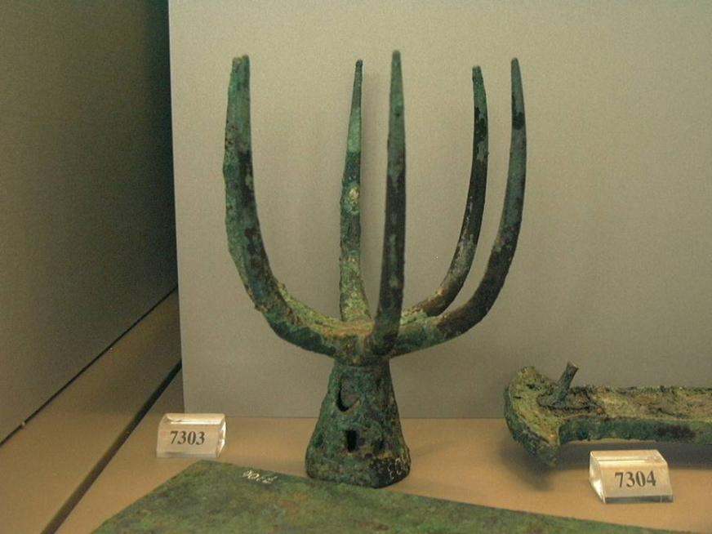
Cast bronze spear head with six points
Notes:
This is a cast bronze spear point. It is about ten inches tall with six points. On the right side is the handle of a sword.

Slide 11
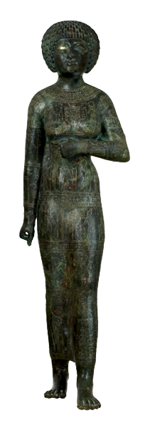
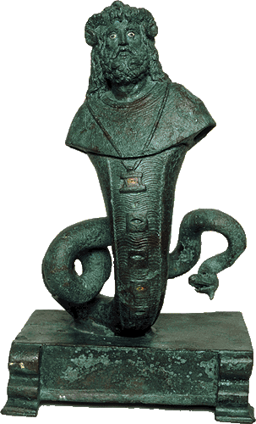
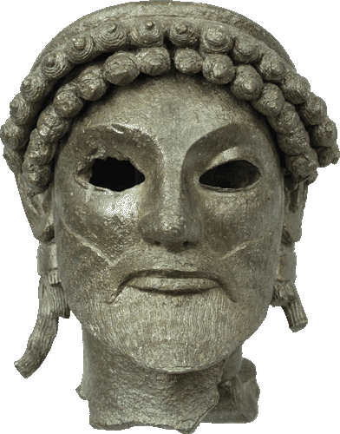
520 BC
Head of Zeus
670 BC
Egyptian Princess
100 BC to 100 AD
Snake god
Notes:
More ancient castings. The princess is ten inches tall and beautifully engraved with many intricate designs.

Slide 12
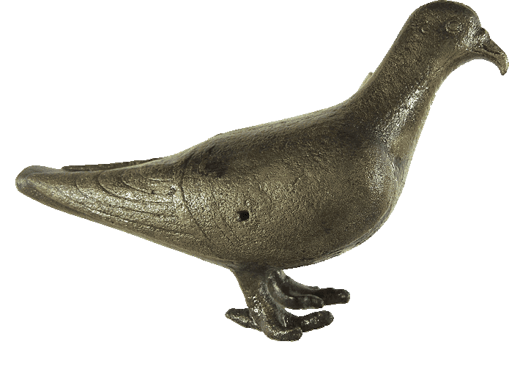
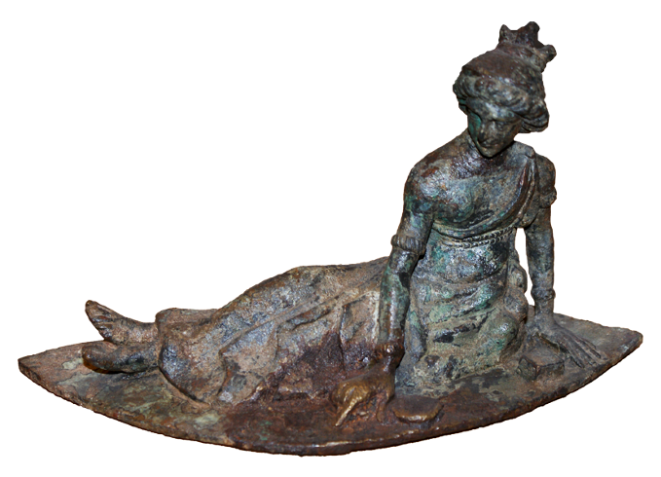
600 BC
Dove
400 AD Woman playing a game
Notes:
More old castings

Slide 13
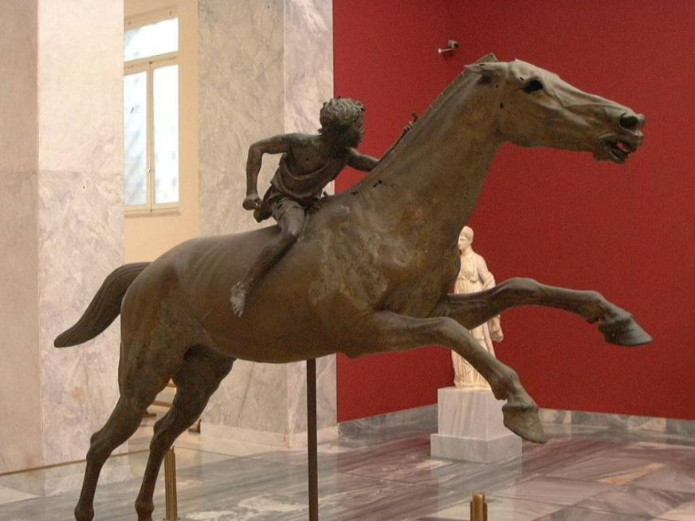
Notes:
This is a boy riding a life-size cast bronze horse. The details appear perfect.

Slide 14
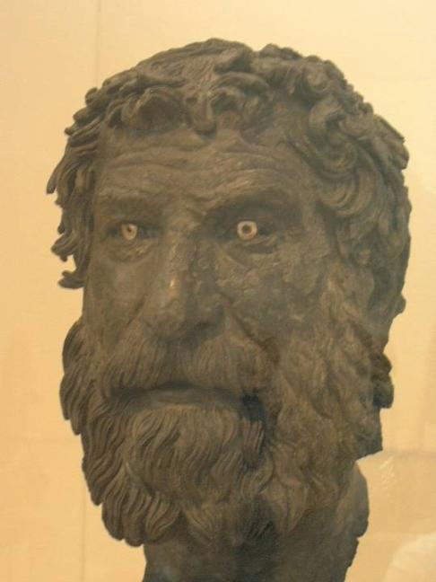
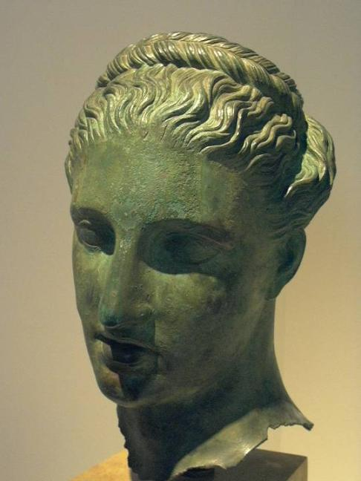
Notes:
This is what the ancient Greeks looked like. They didn’t have cameras so they paid an artist to make a casting that looked like them. The man’s head has ivory eyes.

Slide 15
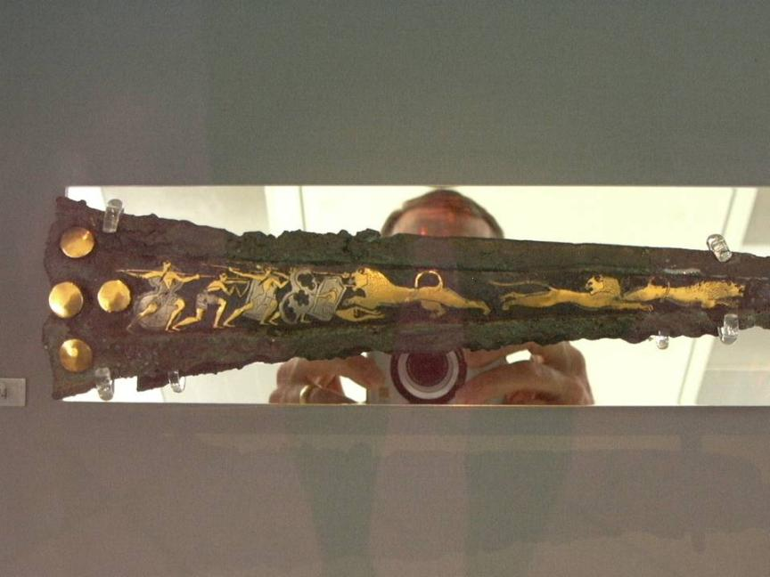
Bronze dagger with gold and silver inlays
1500 BC
Notes:
This cast bronze dagger was made at about the same time that Moses led the Children of Israel. The gold and silver inlays show men fighting lions. (It is laying on a mirror so you see the camera and photographer.) Moses probably used a sword like this when he killed the Egyptian man.

Slide 16
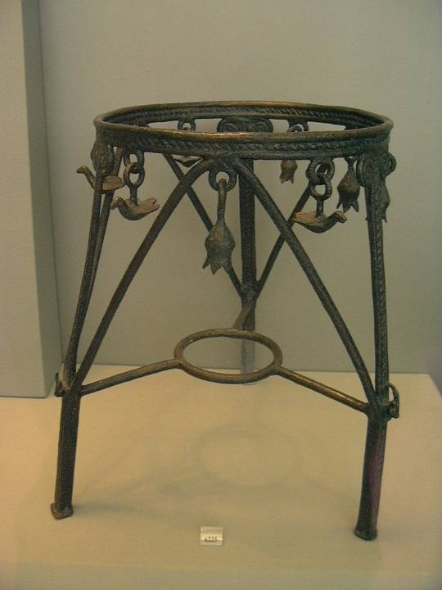
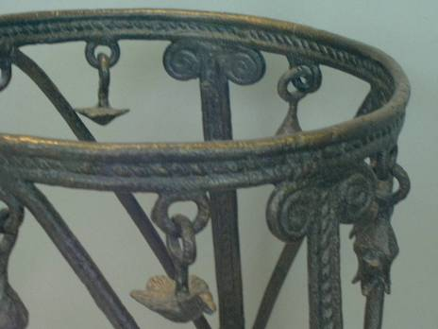
Cast Bronze Stool
With cast chain
link
Ornaments.
Notes:
Note the dangling ornaments are cast with chain links on the rim of this stool.

Slide 17
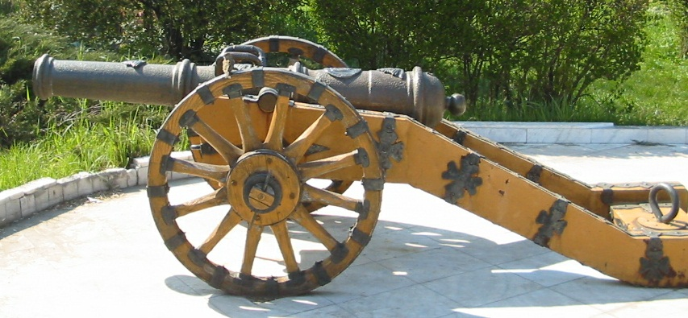
The fate of many nations has been determined by cast bronze and cast iron cannons.
Notes:
In 1332 AD the first cannon is cast in bronze by a monk in the city of Ghent. In the middle ages the fate of many kingdoms depended on the cannons produced by their craftsmen.

Slide 18
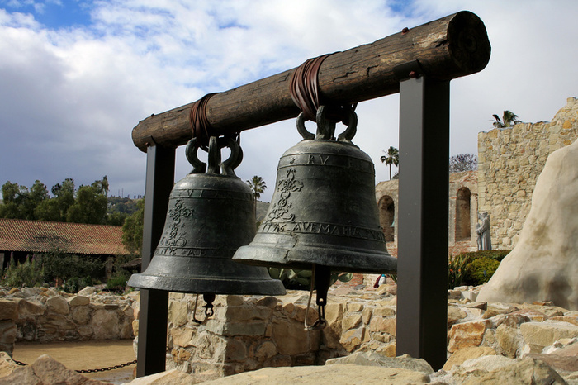
Ancient men discovered that casting is an excellent way to make bells.
Notes:
In times of peace, priests, abbots and bishops melted the cannons to make bells. They stood around the furnace intoning psalms and prayers. The molten metal was blessed and divine protection was asked for the bell, which usually bore the name of a saint. In times of war, they reversed the process and made cannons from the bells.

Slide 19
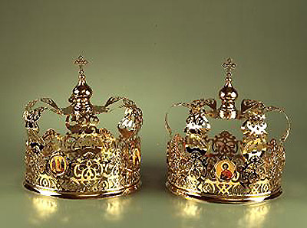
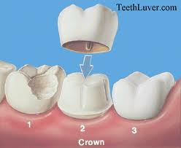
Cast gold crowns -
For royalty.
Cast gold crowns -
For teeth.
Notes:
More modern forms of castings

Slide 20
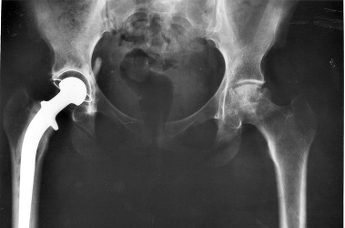
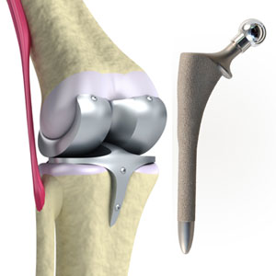
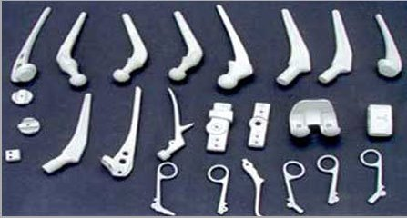
Notes:
Castings used in the body

Slide 21
What
castings
do you
see in
this
room?
Notes:
Ask the students to find objects in the room that are castings. Point out the door handles and sprinkler heads. Mention cell phone and computer frames.

Slide 22
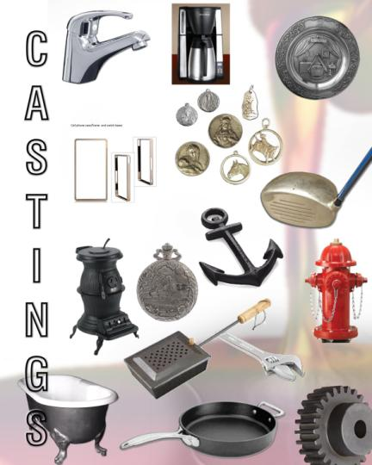
Examples of Casting
Notes:
Other examples of castings

Slide 23
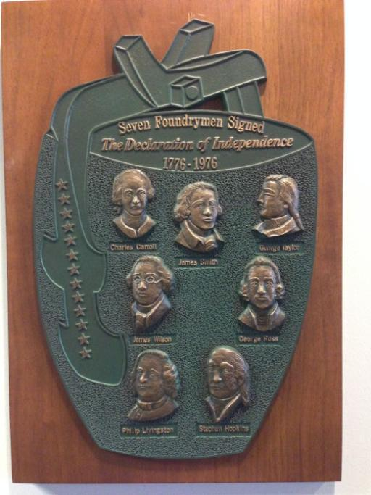
Seven Foundrymen
Signed Declaration of
Independence
Charles Carroll
James Smith
George Taylor
James Wilson
George Wilson
Philip Livingston
Stephen Hopkins
Notes:
If you think that very few people work to make castings, please consider this that “there were 56 men who signed the Declaration of Independence and 7 of them were foundrymen. That is one out of 8 of those men, were foundrymen.

Slide 24
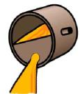

Casting Definition
Dictionary Definition:
  A primary forming method where the part is produced by causing molten metal to fill a shaped cavity
Simplified Definition:
  Combine dirt and glue
  Make hole in it
  Melt some recycled metal
  Pour in Metal
  Let Metal harden
Notes:
Casting (the verb) is a Primary Forming Method whereby the part is produced by causing molten metal to fill a shaped cavity to produce a part of the desired final shape. A casting (noun) is a part so produced and used essentially in this final shape. Since all materials, including those ultimately classed as wrought, are at some point early in their manufacture cast into an ingot or strand before subsequent working, the phrase "of the desired final shape" is an important determinant of what constitutes a casting. Casting can be as simple as making an impression in a refractory media and pouring in molten metal to a sophisticated multi-slide metal mold. At either extreme you are still producing a casting.

Slide 25
Simplified Process Steps to Make a Casting
  Use pattern to make the design (shape of casting)
  Make a mold with sand in a flask
  Make a hole to pour metal in (sprue and runner)
  Melt some scrap metal
  Pour in metal
  Let metal cool
  Separate sand from casting
  Separate runner and sprue from casting
  Cool casting & Final Processing

Slide 26
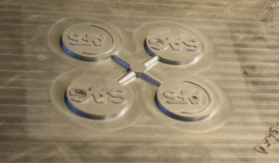
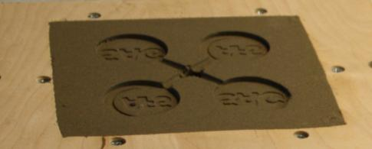
Pattern and Design in Sand
Below is an example of the Pattern to make the shape. Also the design that shape made in the Sand.
Pattern to make the shape
Design in sand

Slide 27
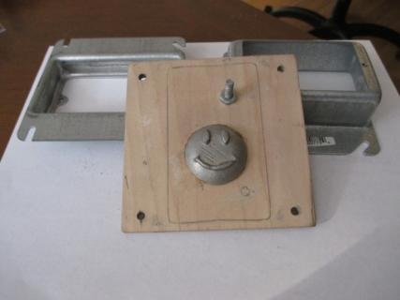
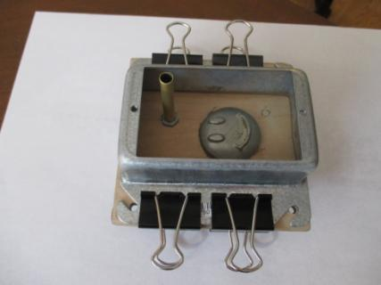
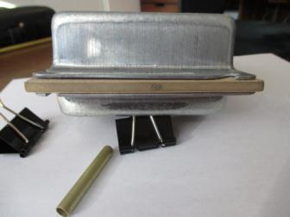
  Use pattern to make the design (shape of casting)
Notes:
To make the casting shape you want, you take a pattern (here the design is mounted to a board) and place it between two flask halves (cope on top and drag on the bottom).

Slide 28
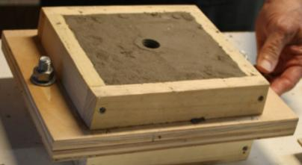
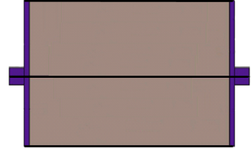
Flask Molding
  Flask is a rigid container to hold Sand
  It is usually has two pieces:
    a “top” called a Cope
    a ‘bottom” called a Drag
  Sand is dropped on pattern, shaken and compressed to remove air
Cope
Drag
Notes:
Green sand molds are produced by dropping the sand on the pattern, jolting the pattern multiple times and then squeezing with a hydraulic press.

Slide 29



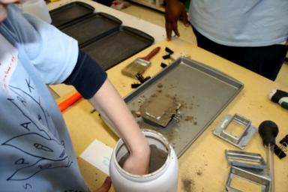
  Make a mold with sand in a flask
  Make a hole to pour metal in (sprue and runner)
Notes:
To make a mold, you fill each flask with sand, packing it in tightly against the pattern. Continue to fill and pack the sand until the flasks are full. After the flasks are filled and molds packed tight, the clamps are removed and the wood pattern is carefully removed.

Slide 30
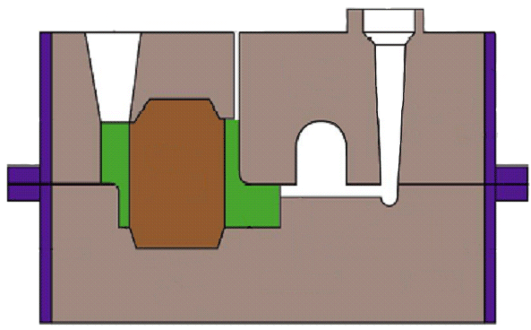



Sand Mold
Vent
Pouring Basin (Cup)
Sand
Flask
Cope
Sprue
Parting Line
Drag
Runner
Sand
Pattern
Shape
Notes:
This schematic of a sand mold shows the filled flask (cope and drag mold) and the pouring basin that the molten metal is poured into so that it flows into the runner to the pattern shape.

Slide 31
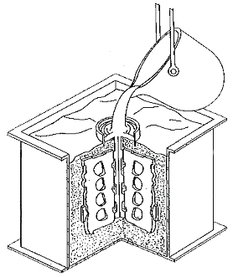
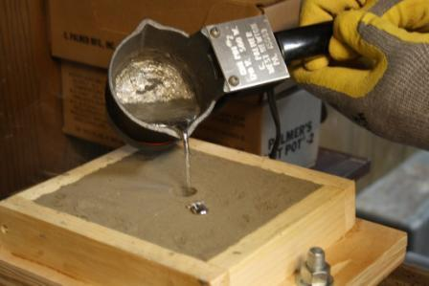




Pour Molten Metal
Pour molten metal into flask to make the casting
Flask
Pouring
Pouring Basin
Compacted Sand
Pattern shape in sand
Notes:
This schematic and photo show the pouring of molten metal into a mold.

Slide 32
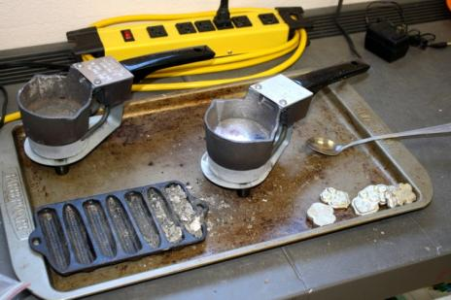

  Melt some scrap metal
  Pour in Tin metal
Notes:
With our Foundry in a Box equipment, we melt the tin nuggets in a electric hot pot to approximately 450 degrees Fahrenheit. Then the molten tin is poured into the sprue hole in the completed mold.

Slide 33
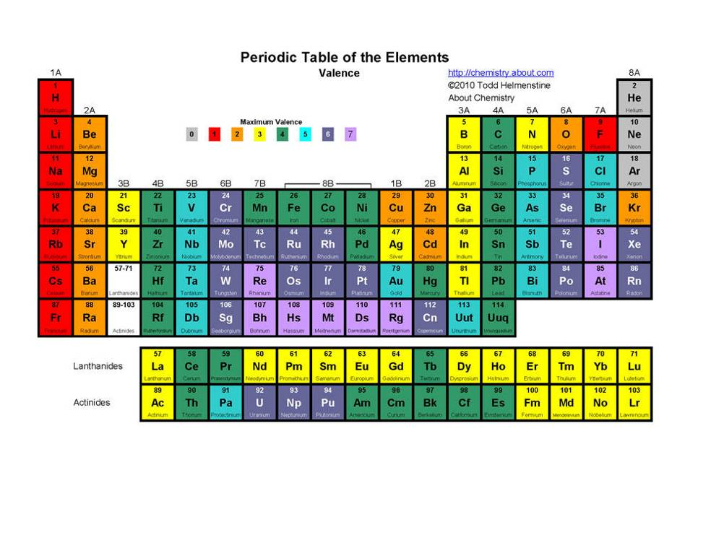
Silicon
Carbon
Oxygen
Aluminum
Tin
Zirconium
Molding Sand = Zircon Silicate
Crucible = Graphite (carbon) and aluminum oxide.
Notes:
This table of elements show where Tin and some of the other elements often associated with metal casting and molten metal.

Slide 34
Melting Temperatures, ᵒF
Titanium, 3035ᵒ
3000
Iron, 2800ᵒ
Steels, 2550ᵒ - 2760ᵒ
2500
Cast Irons, 2060ᵒ - 2200ᵒ
Gold, 1950ᵒ
Copper, 1985ᵒ
2000
Silver, 1765ᵒ
Copper Alloys (bronze, brass), 1650ᵒ - 1750ᵒ
1500
Aluminum, 1220ᵒ
Magnesium, 1200ᵒ
1000
Zinc, 790ᵒ
Lead, 620ᵒ
Tin, 450ᵒ
500
Water (boils), 212ᵒ
Water, 32ᵒ
0
Salt Water, 12ᵒ- 18ᵒ
Notes:
This chart shows melting temperatures of Tin and some of the other elements often associated with metal casting and molten metal.

Slide 35

Sn
Tin is a
chemical element
A soft, silver metal.
Melts at 450ºF.
Non-toxic
When bent,
it makes
a crackling
sound called
“tin cry”.
Malleable
Notes:
Bend a sample of tin and ask the students to listen to it cry. Everyone should be able to hear it.
Ask students to define the word “Malleable”. Bring two students to the front of the room and hand them each a tin sample (A small bar with a handle on each end). Instruct them to twist the sample until it tears into two pieces. This will require about twenty turns to accomplish. The students will be amazed at the malleability of pure tin. Chose two large boys to compete. It requires some hand strength.

Slide 36

At 56ºF and below, pure tin slowly transforms
from white tin to grey tin (a soft powder).
This is called tin pest.
In 1812, nearly 400,000 of Napoleon's men died in the bitter
Russian winter, their clothes falling apart as tin pest ate their buttons.
http://youtu.be/Hb0VoQ-xQhU
Notes:
Tell the story of Napoleon’s Buttons. Show the “tin pest” video if available. The average temperature during the Russian winter of 1812 was -40ºF. Ask the students to imagine trying to fight while holding up their pants with one hand and holding their coat together with the other hand.

Slide 37

Degating Process
Gating is the extra metal from the runner and sprue.
Remove the Gating system and the extra metal gets re-melted
Notes:
Gating is the extra metal when the runner and sprue solidify. These must be removed from the casting and the extra metal is re-melted.

Slide 38

  Separate sand from casting
  Separate runner and sprue from casting
Sprue and runner
Casting
Notes:
This photo shows the casting after it has cooled and has been removed from the mold. The sand is recycled for future use. Note the runner and sprue attached to the casting.

Slide 39

  Cool Casting & Final Processing
Notes:
The casting must then be finished to remove any sharp edges. This is often done with a metal file.

Slide 40
AFS Saginaw Valley Chapter – 3 year FIB Summary
Total number youth served was 21,000
Total number volunteers that helped were 362
(140 different individuals)
Total number events was 31
Total pounds tin used 300 lbs. at a cost of $1,300
Total sand 100 lbs. (donated or bought) and used up 23.5 lbs.
Sand purchased from Kent State for $20 a pound with shipping
Total cost for FIB equipment was approximately $1,000.
Notes:
In our first year taking our “Foundry in a Box” show on the road, we have served 9,088 youth at 14 events. This is a hands on activity, so we had over 155 volunteers that worked our events. Some of our volunteers were sons and daughters of our adult volunteers. We have refined our equipment and process and have enjoyed teaching our youth the metal casting process in a hands on way.

